Slide 1

Progress Report on
Pelvic Bone Fracture with Injury Segmentation
Shirshak Acharya,
Research Assistant, NAAMII

Slide 2
Outline
Hip Bone CT Scan Dataset
Training Pipeline
Anatomical Model
Fracture Segmentation Model
Inference Pipeline
Anatomical Model
Fracture Segmentation Model
Results

Slide 3
Outline
Hip Bone CT Scan Dataset
Training Pipeline
Anatomical Model
Fracture Segmentation Model
Inference Pipeline
Anatomical Model
Fracture Segmentation Model
Results

Slide 4
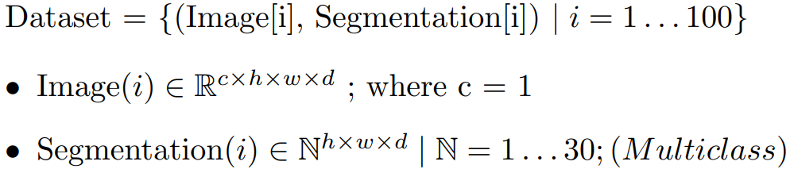
Hip Bone CT Scan Dataset
Task

Slide 5
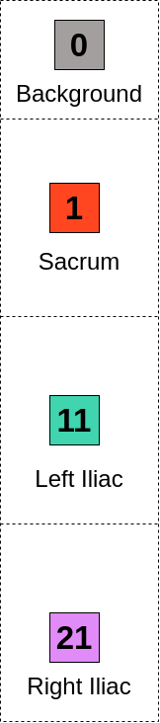
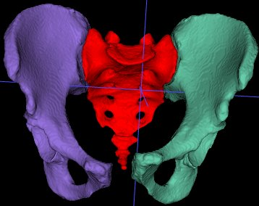
Label For Hip with No Fractures

Slide 6
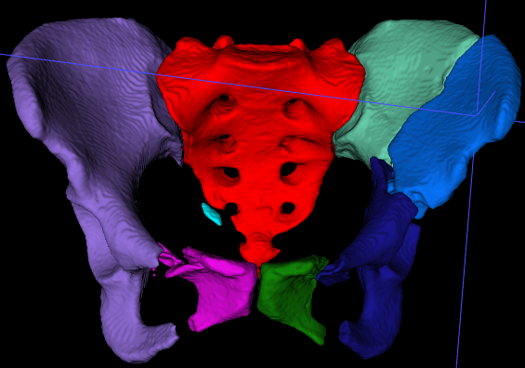
Label For three hip fracture structures

Slide 7
Fracture Example
Hip Part | Fragment Type | Label
Background | - | 0
Sacrum | Main (largest) | 1
 | Remaining | 2
B
0
S
1
2
B : Background
S : Sacrum
L : Left Iliac
R : Right Iliac

Slide 8
Fracture Example
Hip Part | Fragment Type | Label
Background | - | 0
Sacrum | Main (largest) | 1
 | Remaining | 2
Left Iliac | Main (largest) | 11
 | Remaining | 12
 | Remaining | 13
 | Remaining | 14
B
0
S
1
2
L
11
12
13
14
B : Background
S : Sacrum
L : Left Iliac
R : Right Iliac

Slide 9
Fracture Example
Hip Part | Fragment Type | Label
Background | - | 0
Sacrum | Main (largest) | 1
 | Remaining | 2
Left Iliac | Main (largest) | 11
 | Remaining | 12
 | Remaining | 13
 | Remaining | 14
Right Iliac | Main (largest) | 21
 | Remaining | 22
B
0
S
1
2
L
11
12
13
14
R
21
22
B : Background
S : Sacrum
L : Left Iliac
R : Right Iliac

Slide 10
Fracture Example
Main Fragment -> Largest
Main Fragment -> Label 1, 11, 21
Remaining Fragment -> not depend on size. ​
Remaining Fragment -> any order
B
0
S
1
2
L
11
12
13
14
R
21
22
B : Background
S : Sacrum
L : Left Iliac
R : Right Iliac

Slide 11
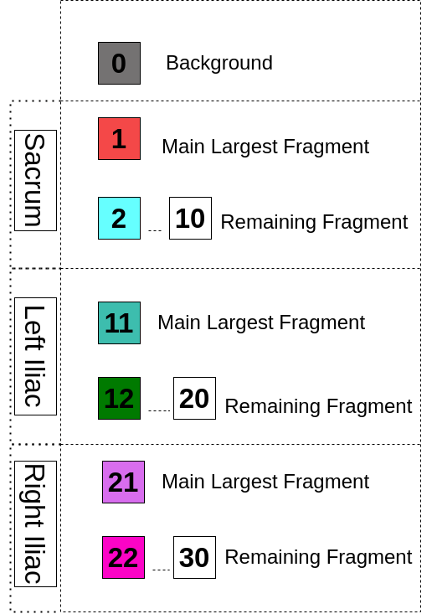
Label For three hip fracture structures
B
0
S
1
2
L
11
12
13
14
R
21
22
B : Background
S : Sacrum
L : Left Iliac
R : Right Iliac

Slide 12
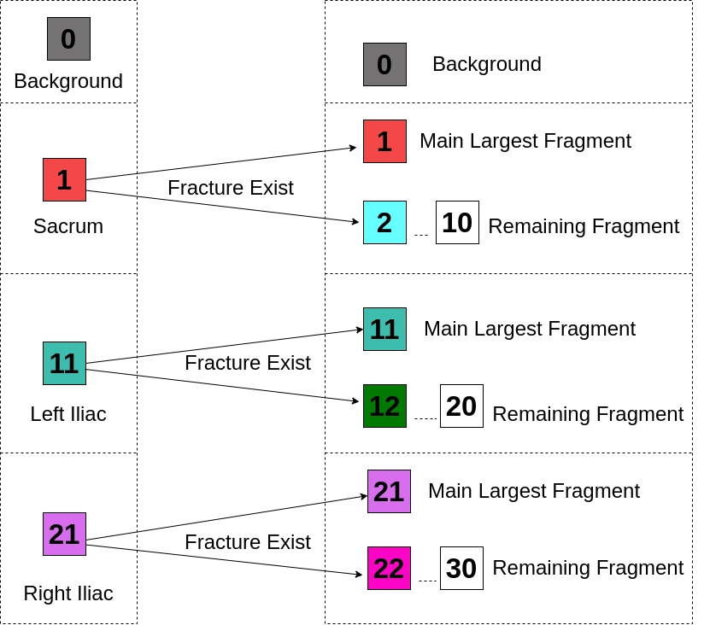
Label For Hip with No Fractures

Slide 13
Labels of 3 hip structures with & without fracture

Slide 14
Labels of 3 hip structures with & without fracture
B
0
S
1
2
L
11
12
13
14
R
21
22
B : Background
S : Sacrum
L : Left Iliac
R : Right Iliac

Slide 15
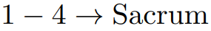
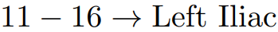
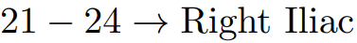
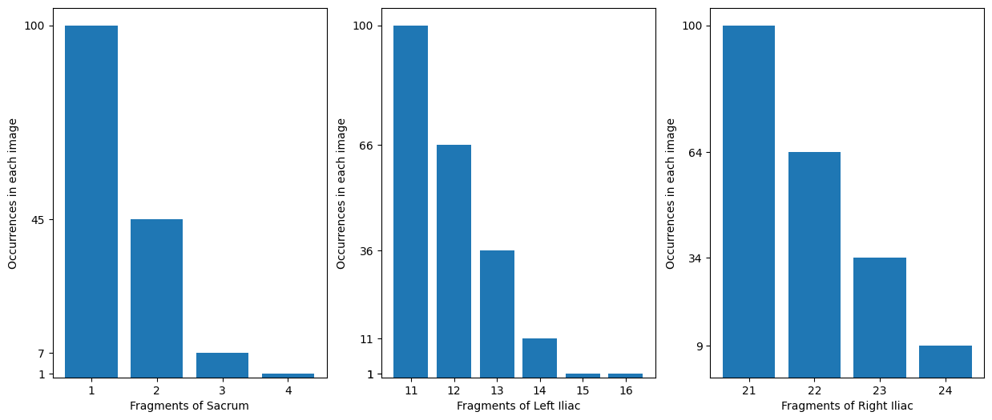
Frequency of Labels
Fig 11.1 : Unique Labels with their number of occurrences.

Slide 16
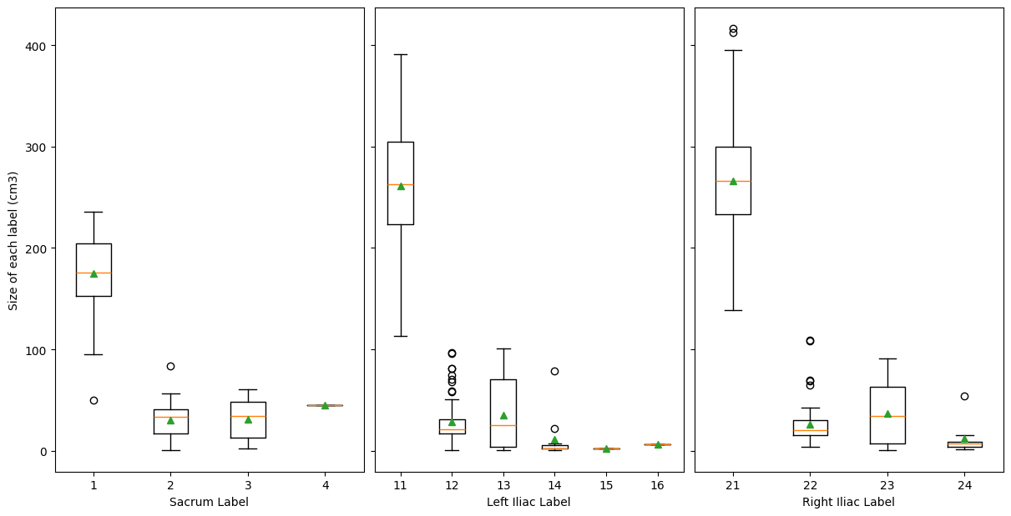
Box Plot of 3 hip structure's label vs their size

Slide 17
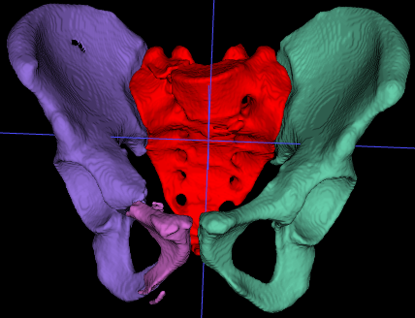
Example Segmentation - label, shape, resolution
Sample Image Name | Image shape | Image Resolution
082.mha | (312, 305, 512) | (0.81, 0.81, 1.0)
Sample Image Name | Unique Labels and Their Value Counts
082.mha | [ 0, 1, 11, 21, 22] [47506096, 320930, 450899, 417283, 26712]
Fig : 6.1

Slide 18
Insights
Only class present on all data : 0(background), 1, 11, 21.
Later classes don't come by themselves.
Class 9 => Class 8 …....... => Class 1
If class 9 is present there must be lower class present.
But, if class 1 is present class 9 not be present.
Similarly, case with class 11.
If class 19 is present, 11 must be present, but not vice versa.
And, class 21.

Slide 19
Problem with data
Classes belong to (Σ) : range(0, 30) but varying classes at different example.
Fluctuation of classes on different examples are seen.
Some regularly occurring labels are present which occur all the time.
Irregularly, occurring labels present which fluctuates.

Slide 20
Possible Solution
Sub-dividing model to focus on more centered data might help.
Previous slide, give analysis that label 0, 1, 11, 21 is always present. (Regular Labels)
So, break down problem into two parts :
One which segments just regularly occurring labels.
Another, which segment multiple fractures.

Slide 21
Limited Data
Only consists of 100 CT Scans given.
Around 348 CT Scan taken from CTPELVIC1K data.
More Data = Better Performance !!

Slide 22
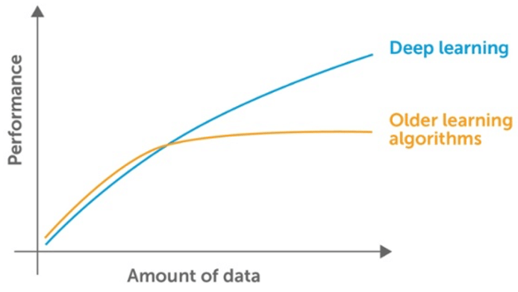
Limited Data
Only consists of 100 CT Scans given.
Around 348 CT Scan taken from CTPELVIC1K data.
More Data = Better Performance !!

Slide 23
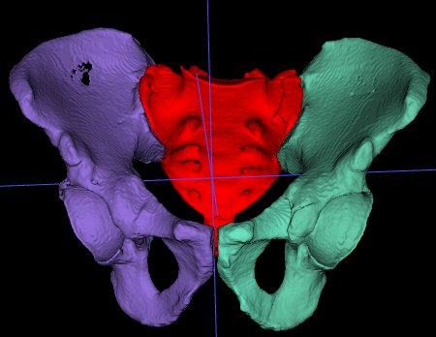
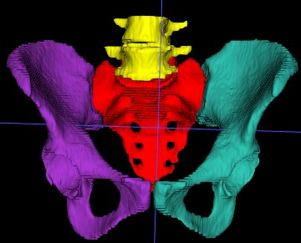
Limited Data
Only consists of 100 CT Scans given.
Around 348 CT Scan taken from CTPELVIC1K data.
More Data = Better Performance !!
Example CT Scan Label : 100 CT FracSeg data
Example CT Scan Label : CTPELVIC1K dataset

Slide 24
Outline
Hip Bone CT Scan Dataset
Training Pipeline
Anatomical Model
Fracture Segmentation Model
Inference Pipeline
Anatomical Model
Fracture Segmentation Model
Results

Slide 25
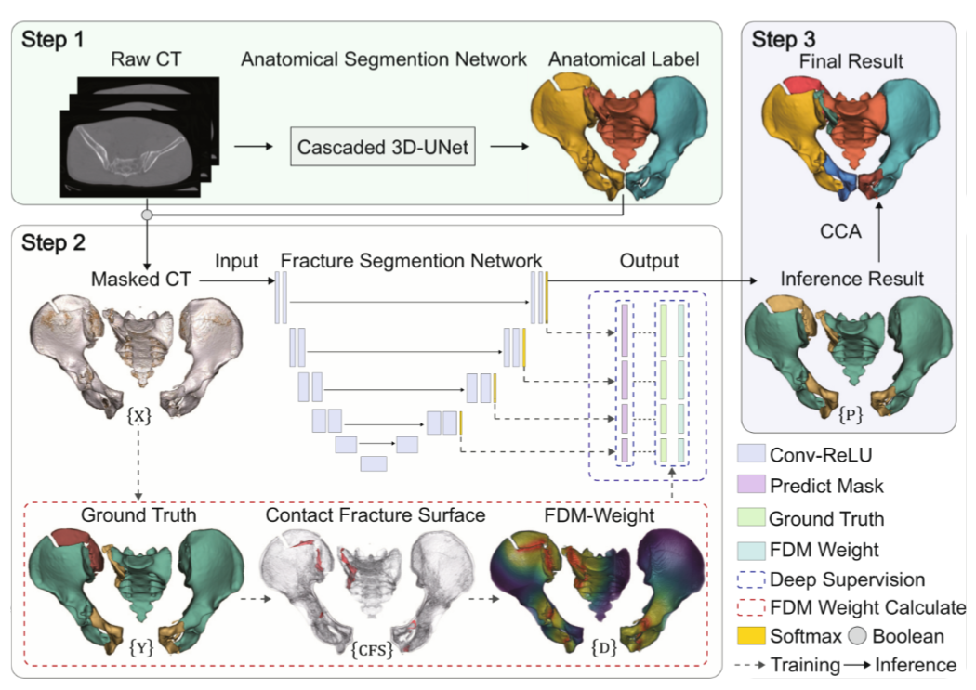
Author proposed Fracture Segmentation Model
Liu Y, Yibulayimu S, Sang Y, Zhu G, Wang Y, Zhao C, Wu X. Pelvic fracture segmentation using a multi-scale distance-weighted neural network. In International Conference on Medical Image Computing and Computer-Assisted Intervention 2023 Oct 1 (pp. 312-321). Cham: Springer Nature Switzerland.

Slide 26
Outline
Hip Bone CT Scan Dataset
Training Pipeline
Anatomical Model
Fracture Segmentation Model
Inference Pipeline
Anatomical Model
Fracture Segmentation Model
Results

Slide 27
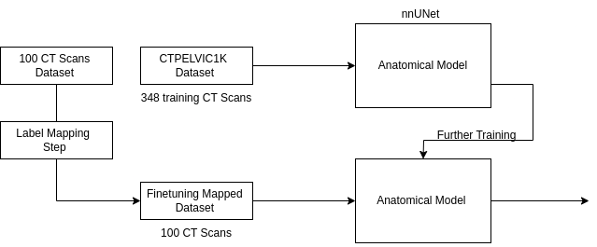

Training Pipeline Anatomical Segmentation

Slide 28
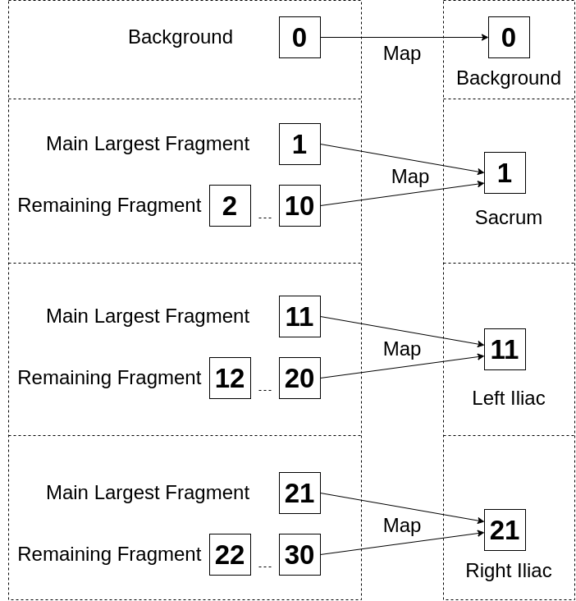
Label Mapping Step

Slide 29
Outline
Hip Bone CT Scan Dataset
Training Pipeline
Anatomical Model
Fracture Segmentation Model
Inference Pipeline
Anatomical Model
Fracture Segmentation Model
Results

Slide 30
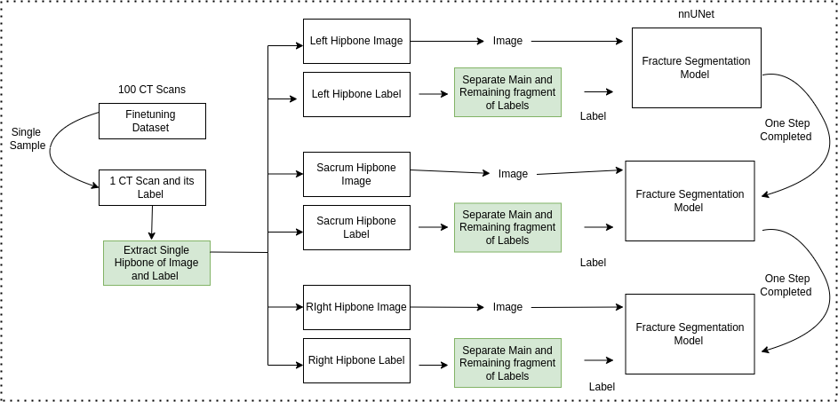
Training Pipeline Fracture Segmentation

Slide 31
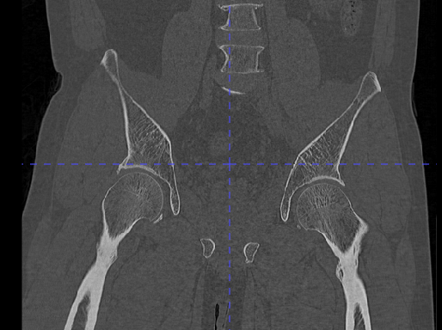
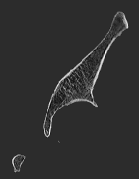
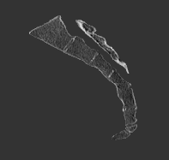
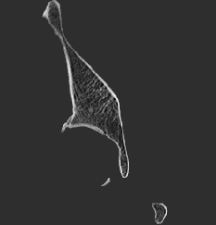
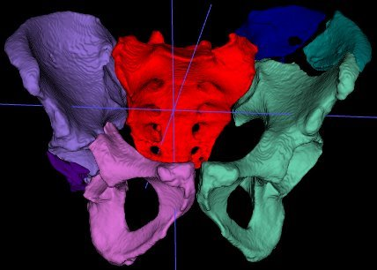
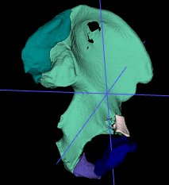
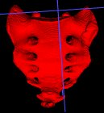
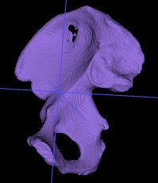
Extract single hipbone part of Image and Label
CT_IMG_LI_001.nii.gz
CT_IMG_LI_001.nii.gz
CT_IMG_LI_001.nii.gz
CT_IMG_LI_001.nii.gz
CT_IMG_001.nii.gz
CT_IMG_LI_001.nii.gz
CT_IMG_SA_001.nii.gz​
CT_IMG_RI_001.nii.gz​
CT_LI_001.nii.gz​
CT_SA_001.nii.gz​​
CT_RI_001.nii.gz​​
CT_IMG_001.nii.gz​

Slide 32
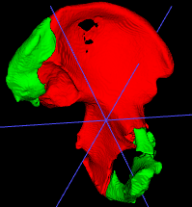
Separate main and remaining fragments of labels
Map multiple Label into main and remaining fragments.
B
0
L
11
12
13
14
B
0
M | R
1 | 2
B : Background
M : Main Fragment
R : Remaining Fragment
B : Background
L : Left Iliac

Slide 33
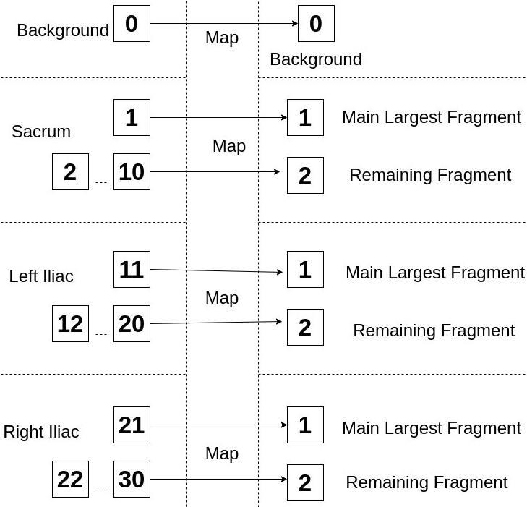
Map Multiple Label in main & remaining fragment

Slide 34
Outline
Hip Bone CT Scan Dataset
Training Pipeline
Anatomical Model
Fracture Segmentation Model
Inference Pipeline
Anatomical Model
Fracture Segmentation Model
Results

Slide 35
Outline
Hip Bone CT Scan Dataset
Training Pipeline
Anatomical Model
Fracture Segmentation Model
Inference Pipeline
Anatomical Model
Fracture Segmentation Model
Results

Slide 36
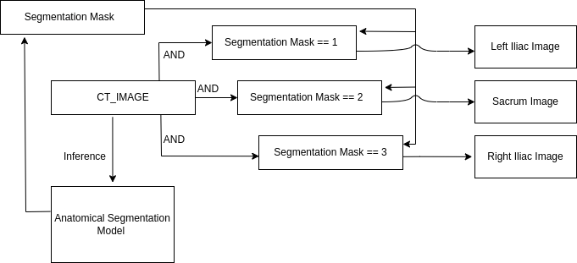
Inference Pipeline Anatomical Segmentation

Slide 37
Outline
Hip Bone CT Scan Dataset
Training Pipeline
Anatomical Model
Fracture Segmentation Model
Inference Pipeline
Anatomical Model
Fracture Segmentation Model
Results

Slide 38
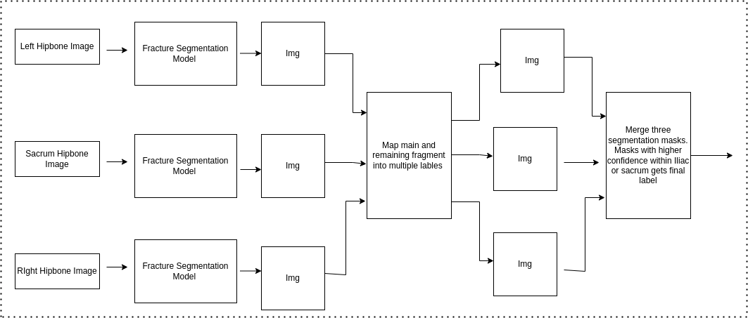

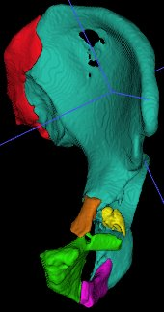
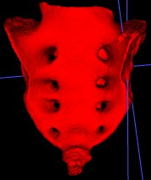
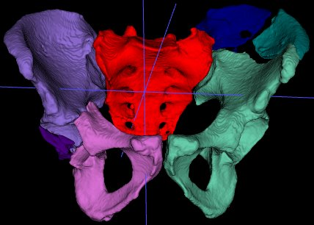
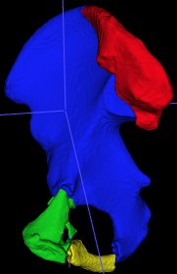
Inference Pipeline Fracture Segmentation

Slide 39
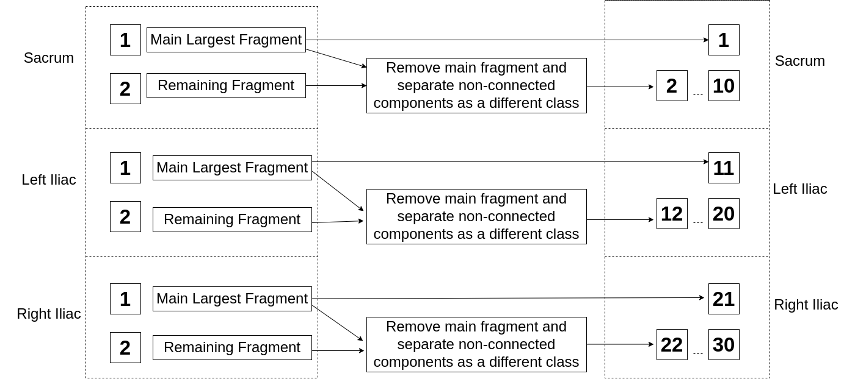
Map main & fragments in multiple labels

Slide 40

Preprocessed Mask (Anatomical Model)
Segmentation Classes | Unique Labels
Background | 0
Sacrum | 1
Left Iliac | 11
Right Iliac | 21
Fig : 2.1
~80 training images, ~20 test images

Slide 41

Segmentation Mask (Fracture Model)
For Class 1 :Sacrum (Best Case Scenario)
Hip Part | Fragment Type | Label
Background | - | 0
Sacrum | main largest | 1
Fig : 3.1
006.mha

Slide 42
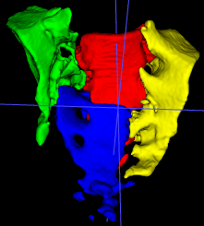
Segmentation Mask (Fracture Model)
For Class 1 :Sacrum (Worst Case Scenario)
Hip Part | Fragment Type | Label
Background | - | 0
Sacrum | main largest | 1
 | Remaining | 2
 | Remaining | 3
 | Remaining | 4
Fig : 3.1
006.mha

Slide 43
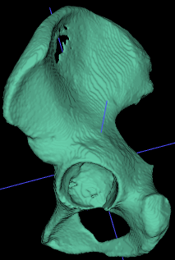
Segmentation Mask (Fracture Model)
For Class 11 :Left Iliac (Best Case Scenario)
Hip Part | Fragment Type | Label
Background | - | 0
Left Iliac | main (largest) | 11
Fig : 3.1
013.mha

Slide 44
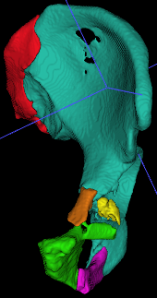
Segmentation Mask (Fracture Model)
For Class 11 :Left Iliac (Worst Case Scenario)
Hip Part | Fragment Type | Label
Background | - | 0
Left Iliac | Main (largest ) | 11
 | Remaining | 12
 | Remaining | 13
 | Remaining | 14
 | Remaining | 15
 | Remaining | 16
Fig : 3.1
049.mha

Slide 45
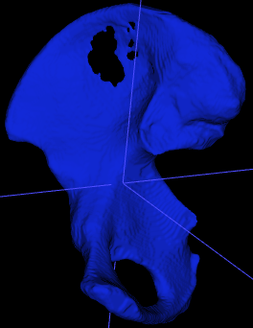
Fracture Segmentation Model Input
For Class 21 :Right Iliac (Best Case Scenario)
Hip Part | Fragment Type | Label
Background | - | 0
Right Iliac | Main (Largest) | 11
Fig : 3.1
013.mha

Slide 46
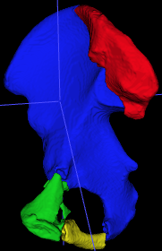
Fracture Segmentation Model Input
For Class 21 :Right Iliac (Worst Case Scenario)
Hip Part | Fragment Type | Label
Background | - | 0
Right Iliac | Main (Largest) | 21
 | Remaining | 22
 | Remaining | 23
 | Remaining | 24
Fig : 3.1
051.mha

Slide 47
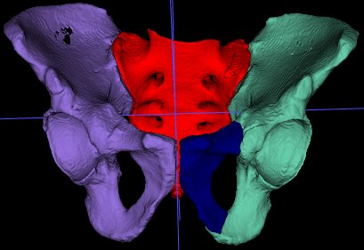
Segmentation Output(Examples)
Sample Image Name | Image shape | Image Resolution
001.mha | (401, 512, 512) | (0.78, 0.78, 0,8)
Sample Image Name | Unique Labels and Their Value Counts
001.mha | [ 0, 1, 11, 12, 21] [102990705, 458539, 762194, 63957, 844349]
Fig : 3.1

Slide 48

Dataset Understanding (Examples)
Sample Image Name | Image shape | Image Resolution
021.mha | (350, 512, 512) | (0.78, 0.78, 0,8)
Sample Image Name | Unique Labels and Their Value Counts
021.mha | [ 0, 1, 11, 12, 13, 21, 22, 23] [89886967, 410407, 546320, 118234, 53100, 502888, 222417, 10067]
Fig : 4.1

Slide 49
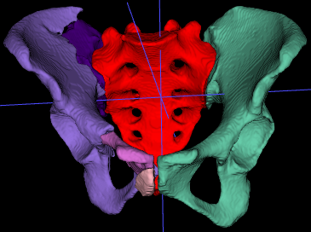
Dataset Understanding (Examples)
Sample Image Name | Image shape | Image Resolution
055.mha | (241, 512, 512) | (0.83, 0.83, 1)
Sample Image Name | Unique Labels and Their Value Counts
055.mha | [ 0, 1, 11, 21, 22, 23, 24] [62213411, 258612, 350371, 245118, 16492, 88534, 4166]
Fig : 5.1

Slide 50
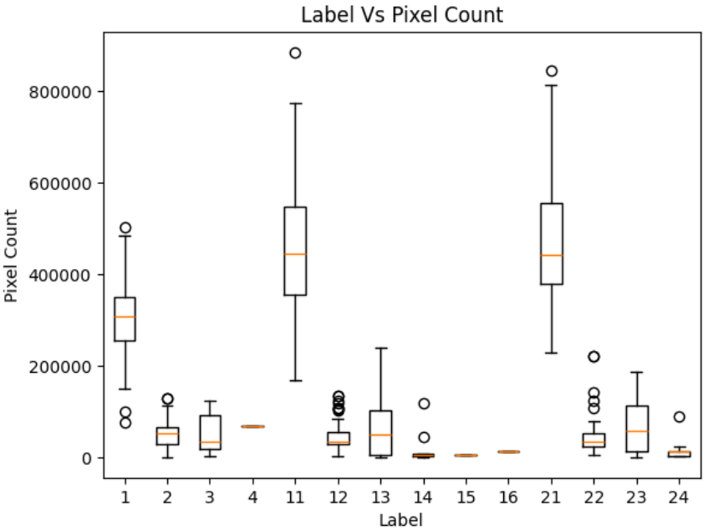
Dataset Understanding (OLD VERSION)

Slide 51
Models Used
Anatomical Model for separation of Hip Bone
Fracture Segmentation Model for Separation of fractures within different hip bone

Slide 52
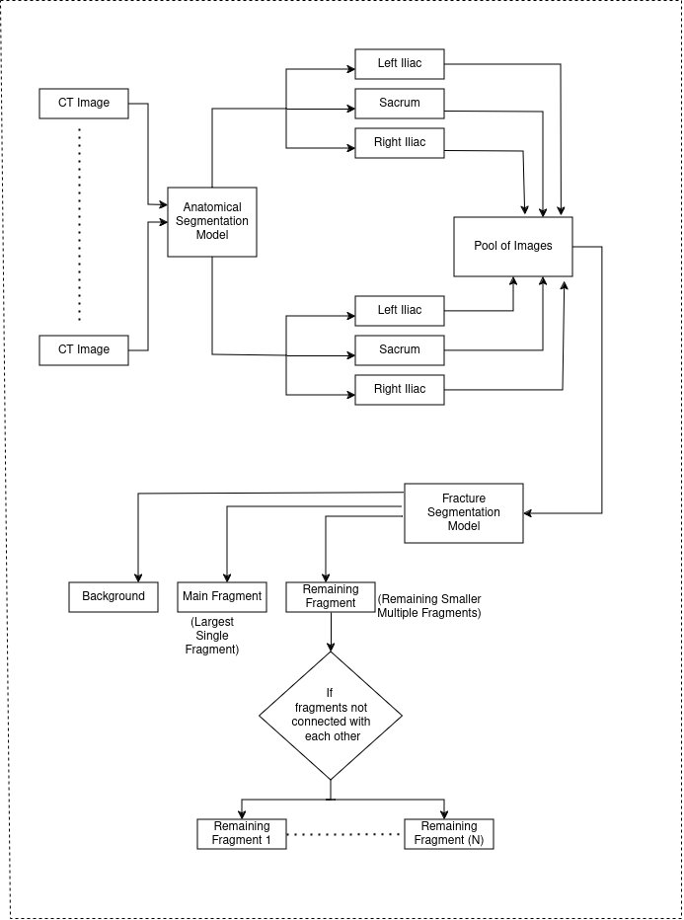
Overall Architecture Inference
1

Slide 53
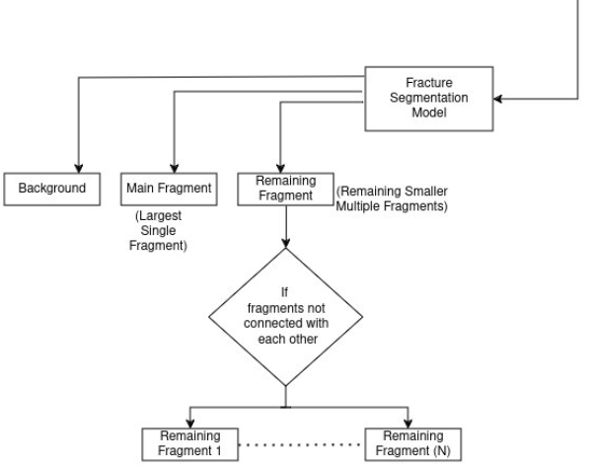
Overall Architecture Inference
1

Slide 54
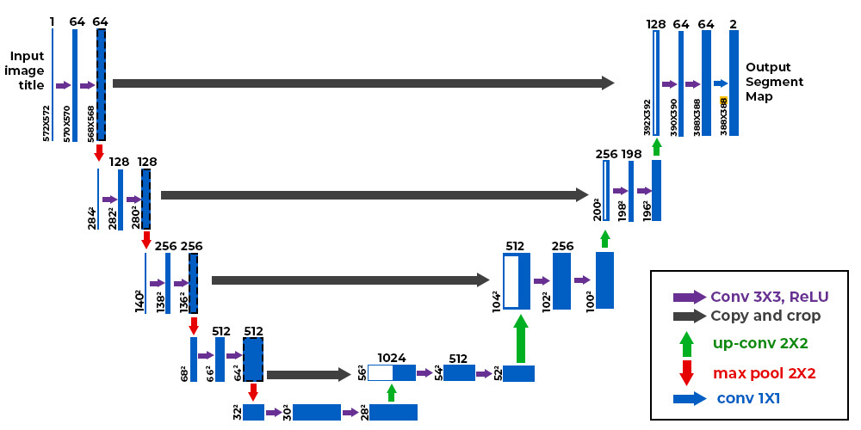
Baseline UNet (author's proposed)

Slide 55
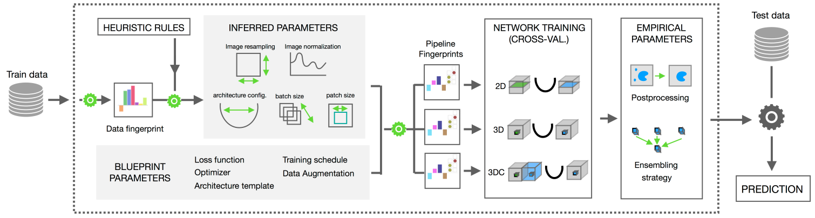
nn-UNet (author's proposed)
Fig : nn-UNet
https://pubmed.ncbi.nlm.nih.gov/33288961/

Slide 56
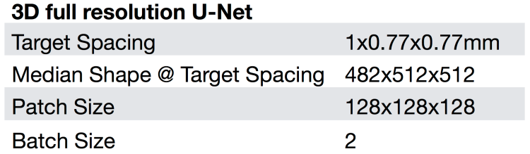
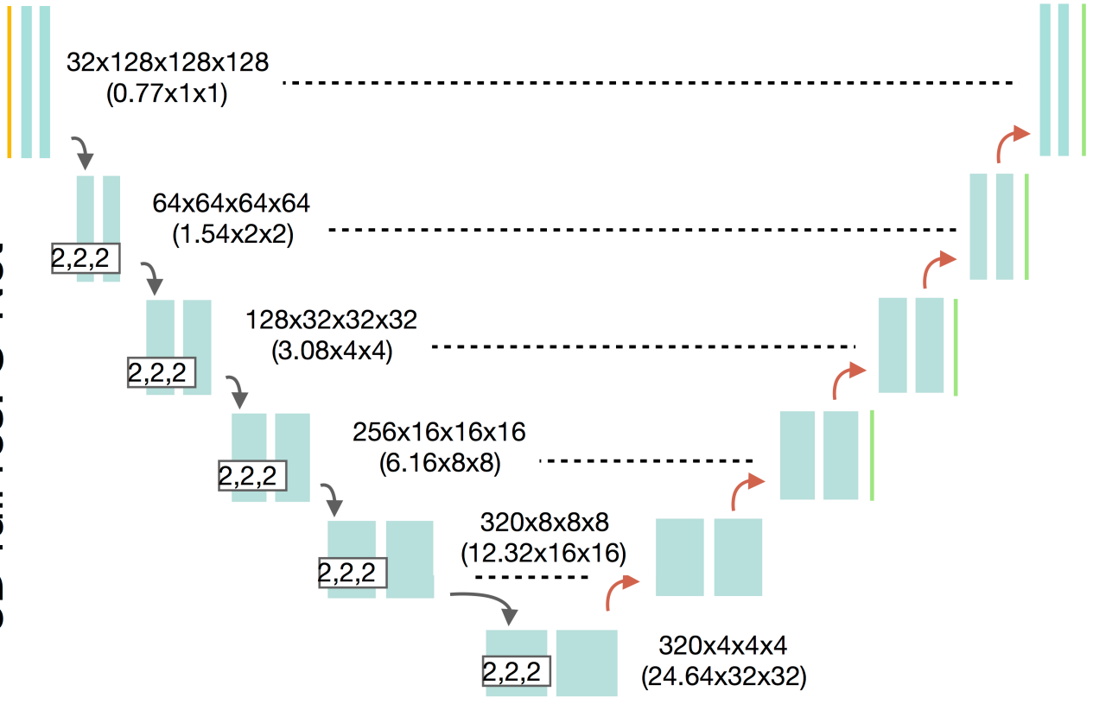

nn-UNet (author's proposed)
Fig : 3D full res. U-Net
https://pubmed.ncbi.nlm.nih.gov/33288961/

Slide 57
Anatomical Segmentation Network (author's proposed)
A cascaded 3D nn-UNet Architecture.
The network is pre-trained on a set of healthy pelvic CT images [nn-UNet,CT-Pelvic1k] and further reﬁned on 100 fractured dataset.

Slide 58
Fracture Segmentation Network (author's proposed)
A 3D nn-UNet is selected as the base model [1].
A guidance into a network is introduced using FDM(Fracture Distance Map).

Slide 59
Contact Fracture Surface (CFS) (author's proposed)
Part where bones collide & overlap due to compression and impact.
How CFS region are identified ?
Comparing the labels within each voxel neighborhood.

Slide 60
Fracture Distance Map (FDM) - Overview (author's proposed)
FDM of ground truth data computed before training
It gives boundary, shape & position of object to be segmented.

Slide 61



Fracture Distance Map (FDM) - Details (author's proposed)
First, CFS region are identified.
Then, we calculate distance of each foreground voxel to nearest CFS as its distance value Dv.
And divide it by the maximum.

Slide 62





Calculation of FDM Weight (author's proposed)
The distance is then used to calculate FDM weight( )
To ensure the equivalence of the loss among diﬀerent samples, the weights are normalized so that the average is always 1.
∵ = 0.2, = 16

Slide 63
FDM Weighted Loss (author's proposed)
FDM weight( ) is then used to calculate weighted Dice & Cross entropy loss.
emphasize performance near CFS by assigning larger weight to those pixel .

Slide 64


FDM Weighted Loss (author's proposed)

Slide 65

FDM Weighted Loss (author's proposed)
The overall loss is weighted sum of dice and cross entropy.
=1

Slide 66
FDM-UNet performance (author's proposed)
Table 2: Quantitive segmentation using different models. LDSC reported in percentage, HD in mm. Statistically significant differences compated to FDMSS –UNet are indicated by * (p < 0.05)
 | I-main | I-other | S-main | S-other | All
DSC | 99.38 ± 0.13* | 92.88 ± 1.30* | 98.66 ± 0.33* | 87.91 ± 1.55* | 96.60 ± 0.89*
Local DSC | 90.68 ± 1.22* | 86.58 ± 1.69* | 84.44 ± 1.77* | 78.50 ± 2.50* | 86.86 ± 1.70*
HD95 | 43.42* | 50.21* | 27.14* | 76.69* | 46.11*

Slide 67

(author's proposed) Multi Scale Attention and Deep Supervision based 3D UNet (MAD)

Slide 68

Long Short Skip Connection (LSSC)

Slide 69

Attention Module

Slide 70
FDMSS (author's proposed)
Combination of :
Multi Scale Attention and Deep Supervision based 3D UNet
Loss Function : FDM Weighted Loss

Slide 71
FDMSS-UNet performance (author's proposed)
Table 3: Quantitive segmentation using different models. LDSC reported in percentage, HD in mm.
 | I-main | I-other | S-main | S-other | All
DSC | 99.78 ± 0.13* | 92.88 ± 1.30* | 98.66 ± 0.33* | 87.91 ± 1.55* | 96.60 ± 0.89*
Local DSC | 90.68 ± 1.22* | 86.58 ± 1.69* | 84.44 ± 1.77* | 78.50 ± 2.50* | 86.86 ± 1.70*
HD95 | 43.42* | 50.21* | 27.14* | 76.69* | 46.11*

Slide 72
Outline
Hip Bone CT Scan Dataset
Training Pipeline
Anatomical Model
Fracture Segmentation Model
Inference Pipeline
Anatomical Model
Fracture Segmentation Model
Results

Slide 73

Results
We trained the model for entire data supplied to us for better performance at submission.
So we don't have test scores yet.
While submission, inference time during submission exceeded the time limit too.

Slide 74
Evaluation Metrics
Average Symmetric Surface Distance (ASSD)
Hausdorff Distance at 95 percentile (hd95)
Intersection Over Union (IOU)
Dice Loss

Slide 75




Anatomical Segmentation Result
Segmentation of 012 Image
Prediction of 012 Image
Train Dice Score : 0.9786

Slide 76
Anatomical Segmentation Result
Segmentation of 049 Image
Prediction of 049 Image
Train Dice Score : 0.9739

Slide 77


Anatomical Segmentation Result
Segmentation of 083 Image
Prediction of 083 Image
Train Dice Score : 0.9723

Slide 78
Anatomical Segmentation Overall Results
Overall Dice Score | 0.9738

Slide 79
Results
Metrics Used | Model | I-main | I-other | S-main | S-other | All
Dice Metric | FDMSS UNet (ours) | 92.64 | 72.18 | 86.63 | 67.59 | 90.63
 | FDMSS UNet (author) | 99.78 | 99.05 | 99.57 | 97.87 | 99.38
HD95 | FDMSS UNet (ours) | 74.81 | 128.54 | 100.26 | 61.91 | 83.29
 | FDMSS UNet (author) | 13.24 | 19.43 | 14.85 | 19.89 | 17.12

Slide 80


Fracture Segmentation Result
Segmentation of 012 Image
Prediction of 012 Image
Train Dice Score : 0.9723

Slide 81
Final Results Upon Submission (Ours)
Model | Hausdorff Distance (hd95) | IOU | Average Symmetric Surface Distance (assd)
Anatomical Segmentation Model (Unet) | 27.185 | 0.6694 | 4.211
Overall Fracture Segmentation (Unet) | 83.096 | 0.31149 | 20.706

Slide 82
Final Results Upon Submission (First)
Model | Hausdorff Distance (hd95) | IOU | Average Symmetric Surface Distance (assd)
Anatomical Segmentation Model (Unet) | 2.3863 | 0.9810 | 1.2895
Overall Fracture Segmentation (Unet) | 5.8656 | 0.9296 | 1.8427

Slide 83


Fracture Segmentation Example Results
049_label.mha
049_pred.mha
Model | hd95 | IOU | assd
Anatomical Model (Unet) | 7.044 | 0.714 | 2.522
Fracture Model (Unet) | 88.83 | 0.308 | 21.33

Slide 84

Examples Result
055_label.mha
055_pred.mha
Model | hd95 | IOU | assd
Anatomical Model (Unet) | 7.24 | 0.6853 | 2.35
Fracture Model (Unet) | 79.28 | 0.303 | 20.99

Slide 85

Examples Result
082_label.mha
082_pred.mha
Model | hd95 | IOU | assd
Anatomical Model (Unet) | 5.55 | 0.72 | 2.43
Fracture Model (Unet) | 22.56 | 0.582 | 5.11

